Slide 1
CS3317 project
Group member:
吴敏 517070910019
苏畅 520021910062
宋依雯 519370910181

Slide 2
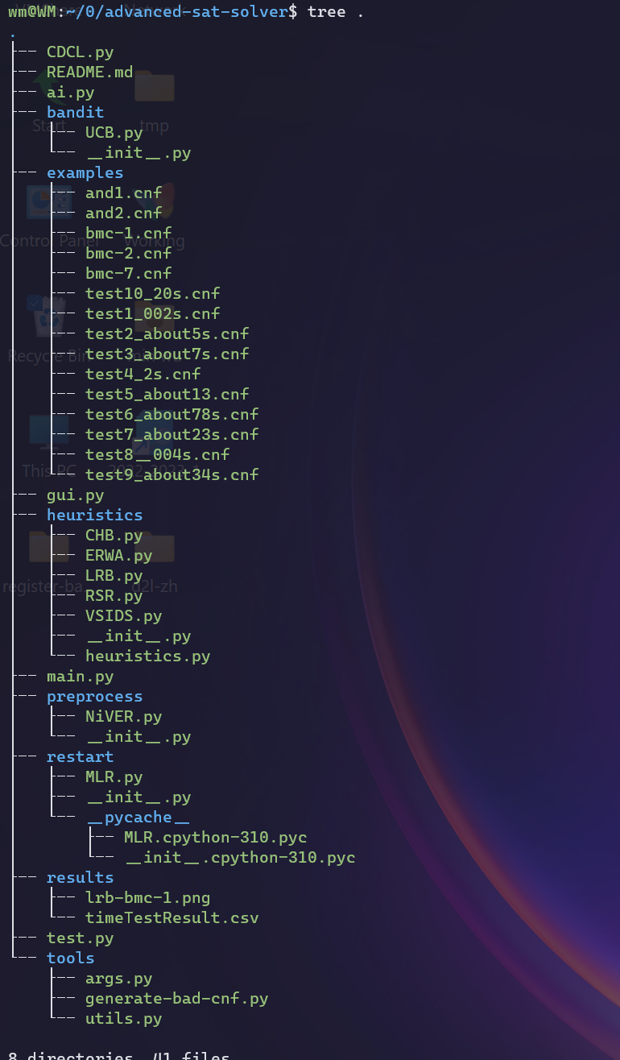
01. Fundamental changes
Outline
02. Requirements
03. Demo
04. Performance

Slide 3
01. Fundamental changes
Data structure
class AssignInfo
Reduce the complexity of the major operations from O(N) to O(logN)
Modules
improve the program's structure and clarity
facilitate workload division and collaboration
heuristic, restart, bandit and preprocess

Slide 4
02. Requirements
2.1 Better branching heuristics
class Heuristic
VSIDS-based - VSIDS
LRB-based - ERWA, RSR and LRB
CHB-based - CHB

Slide 5
02. Requirements
2.2 Restarting
MLR (machine learning-based restart)
decide whether to restart
UCB
applied after a restart
decide which heuristic to choose

Slide 6
02. Requirements
2.3 Preprocessing techniques
NiVER (non-increasing variable elimination resolution)
check whether a variable can be removed
A lighter NiVER
produce fast preprocessing
Pure literal elimination
remove all clauses that contain a pure literal

Slide 7
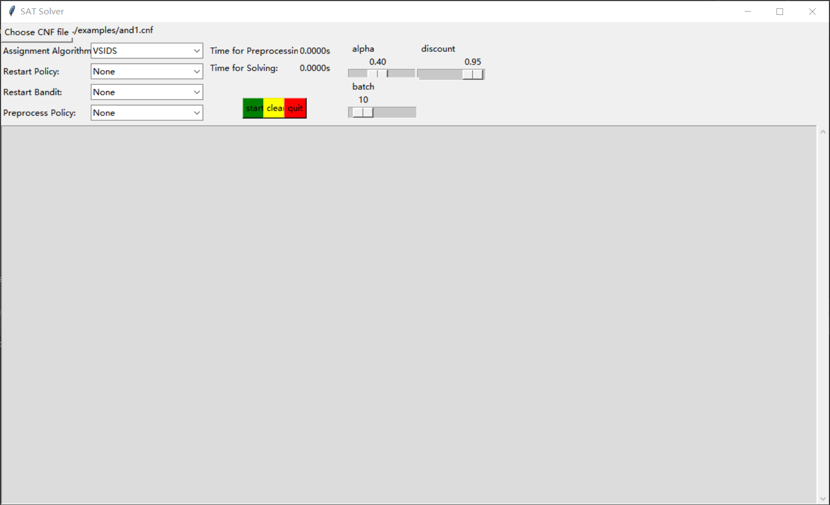
03. Demo
3.1 auxiliary testing tools
GUI
Test script

Slide 8
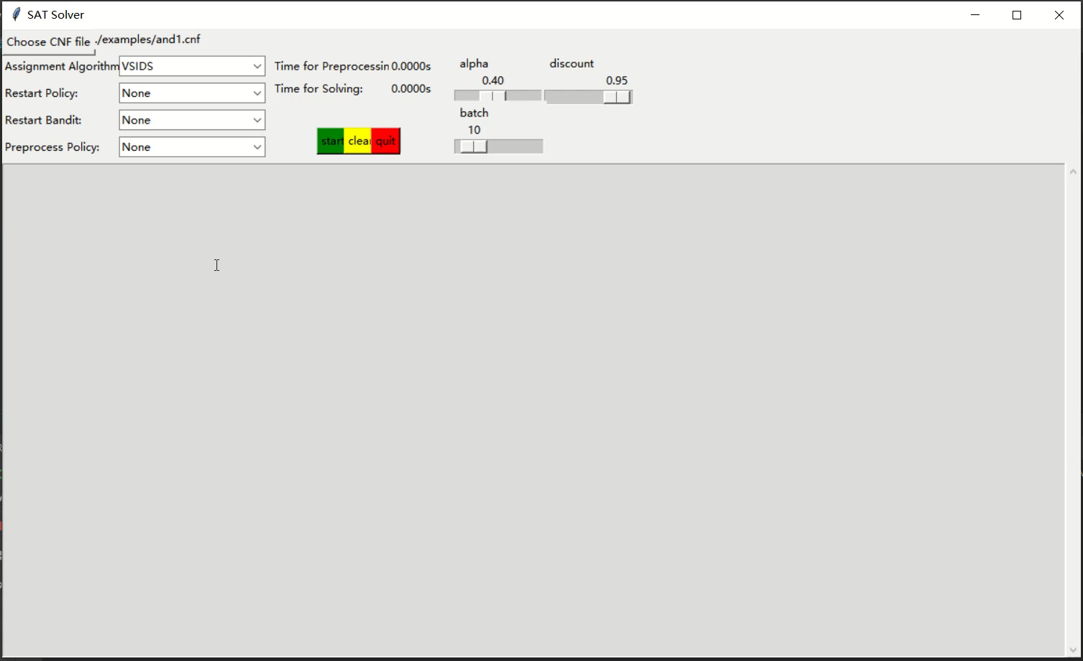
03. Demo

Slide 9
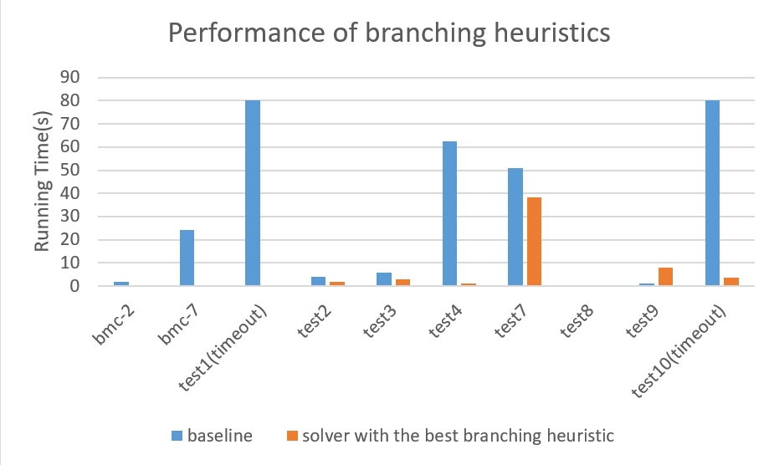
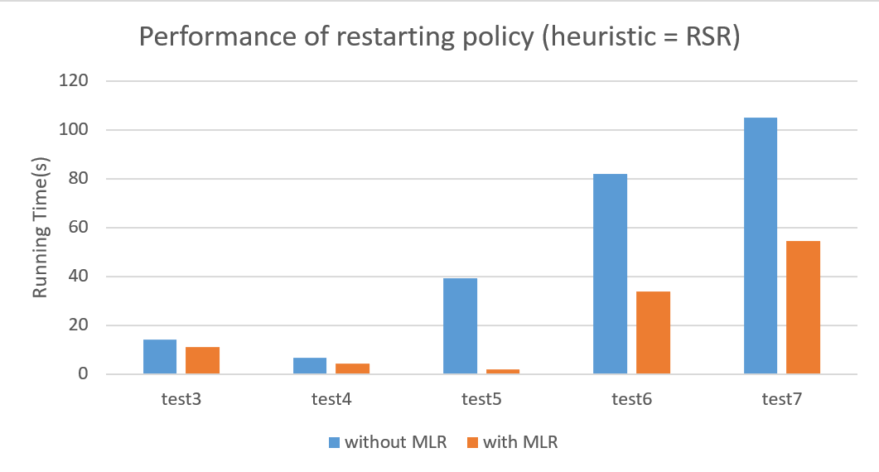
04. Performance
 | Baseline | The best heuristic
bmc-1 | 1095.44s | 4.45s(RSR)
test1 | ≥30min | 0.0040s(LRB)
test10 | ≥30min | 3.65s(CHB)
4.1 branching heuristics
heuristic = VSIDS | without MLR | with MLR
test3 | 7.06s | 1.75s
test5 | 116.07s | 9.88s
test7 | 128.63s | 16.06s
4.2 restarting policy

Slide 10
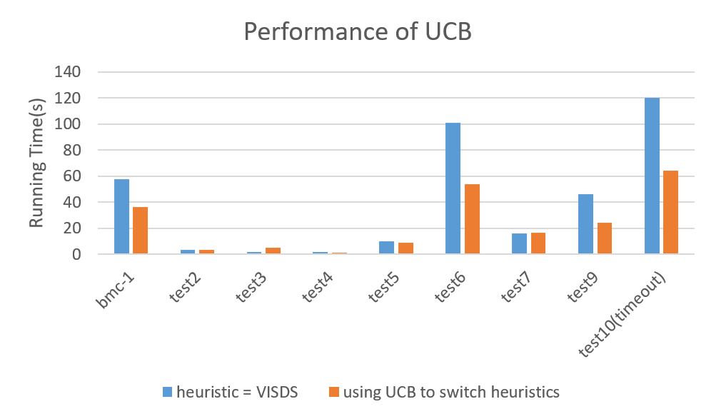
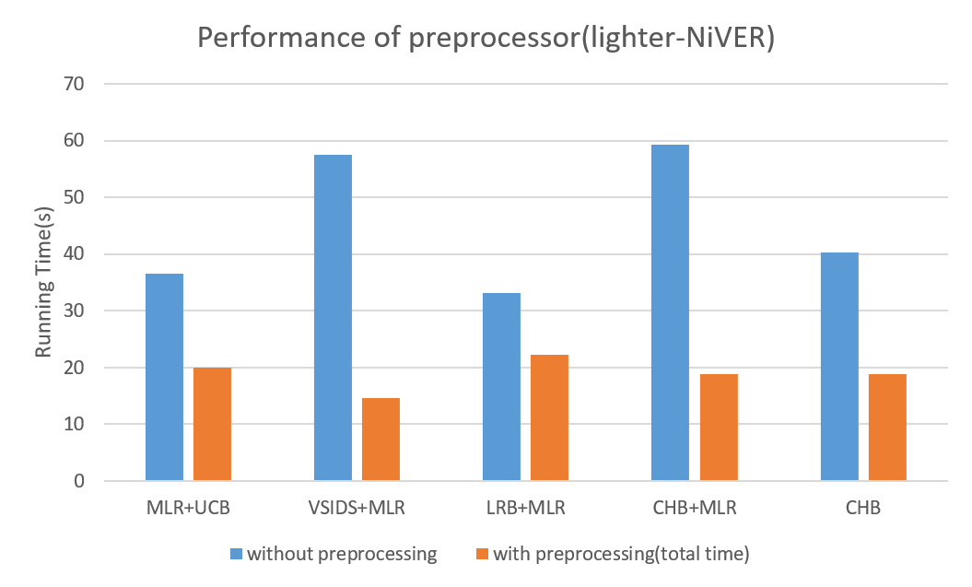
04. Performance
using MLR | heuristic = RSR | with UCB
test7 | 54.43s | 16.52s
test9 | ≥200s | 24.36s
test10 | ≥200s | 64.22s
4.3 bandit
bmc-1 | without llighter-NiVER | with lighter-NiVER
VSIDS+MLR | 57.5 | 14.53
LRB+MLR | 33.15 | 22.21
CHB+MLR | 59.2 | 18.76
4.4 Preprocessing

Slide 11
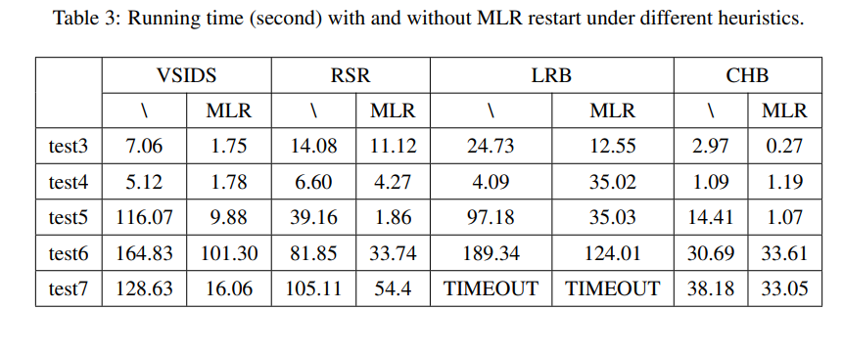
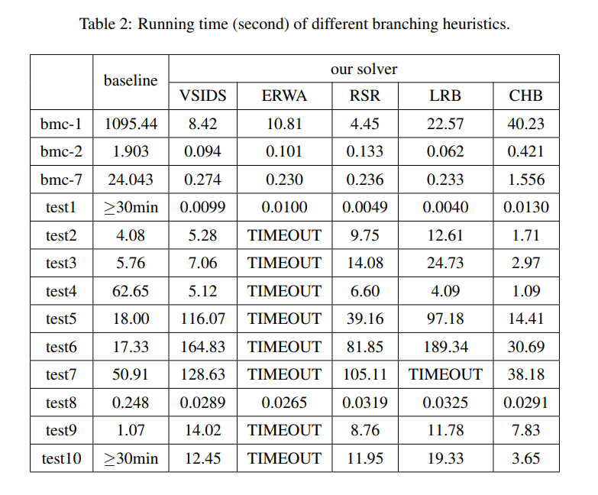
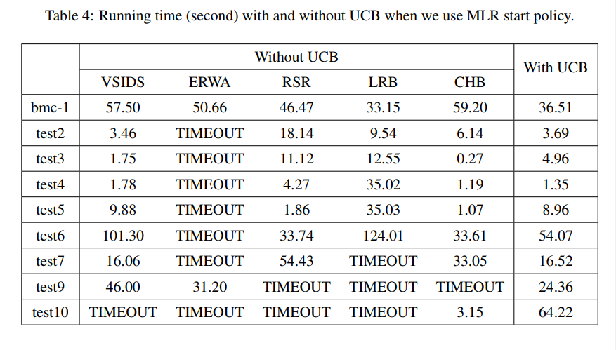
04. Performance
More data …

Slide 12
Future work…
More bandit algorithms
Eg. EXP3
other preprocessing techniques
Eg. subsumption
parallel techniques in python

Slide 13
GitHub repository URL: https://github.com/qiemanqieman/advanced-sat-solver
Thank You

